Slide 1
Module 3: From Continental to World Power
Talk | Title | Time Period | Date of Talk
16 | Competing destinies | 1848-1854 | March 4th
17 | The Union falls apart | 1854-1861 | March 18th
18 | Civil War | 1861-1865 | Wednesday April 3rd
19 | Reconstruction & the New South | 1865-1900 | April 15th
20 | Conquest of the West | 1865-1890 | April 29th
21 | Triumph of capital | 1865-1894 | Wednesday May 8th
22 | A world power emerges | 1890-1904 | May 20th

Slide 2
American History
1
Talk 18: Civil War 1861-1865

Slide 3
Overview
Two countries, two Presidents
The fight to save the Union 1861-1862
War to End Slavery 1862-1863
Total War 1864- 1865

Slide 4
Two Countries, two Presidents

Slide 5
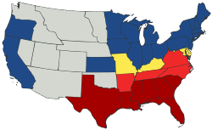
The Divided Union
Deep South
Slave States
Border Slave
States joined South after Sumter
Neutral
Slave States
The North
Free States

Slide 6
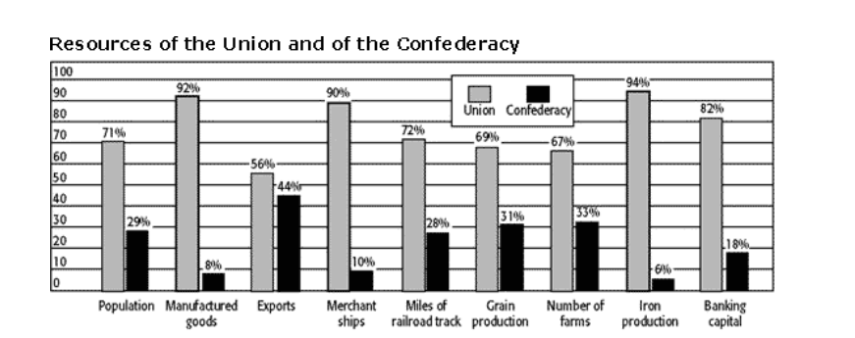
North has all advantages…on paper

Slide 7
Southern Advantages
Win by continuing to exist, North must invade to win
More Militarised & Motivated
decades of “Slave Patrols”
Leadership social class
Fighting for “their country”….North fighting for the “Union”
More homogenous population
Low levels of immigration...North 2 million immigrant, uncertain loyalty
Less divisive media…legacy of censorship
More concentrated & easier to mobilise fast

Slide 8
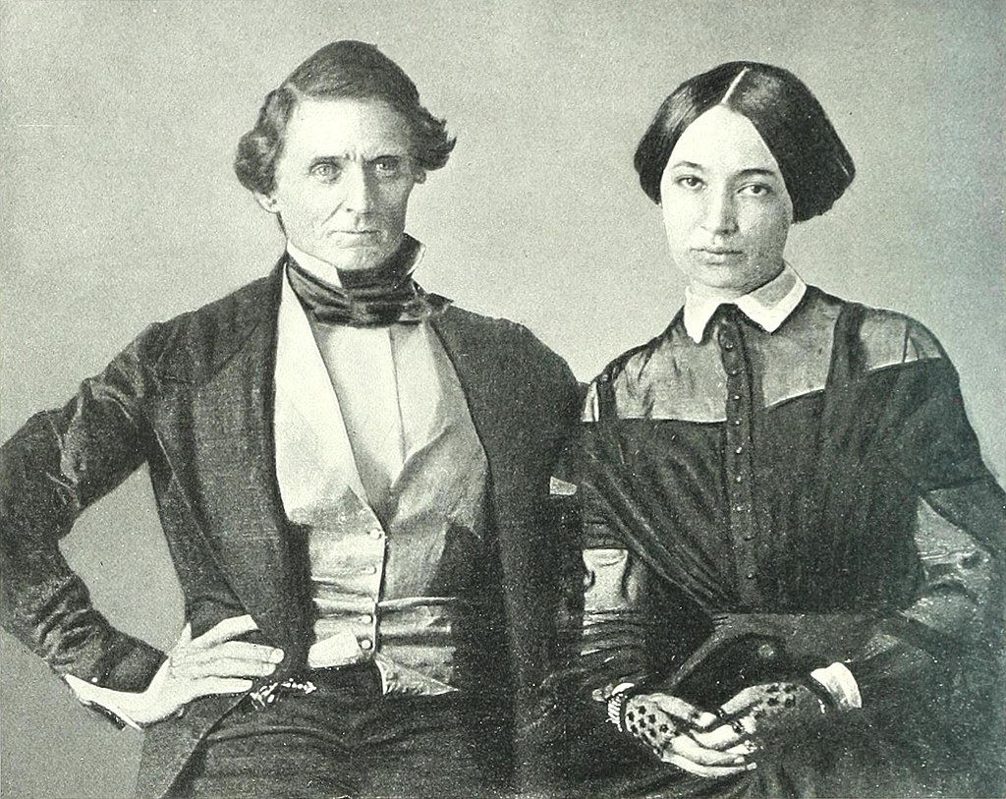
Jefferson Davis (1808-1889)
Born Kentucky Father revolutionary war hero, land grant, Brothers War of 1812
West Point military, s Black Hawk war,
Marries General’s daughter ...takes over plantation from brother
Enters politics 1842 at 35, Democrat Slavery
expansionist, wife dies, meets 18 year old Varina
…”He impresses me as a remarkable kind of man, but of uncertain temper, and has a way of taking for granted that everybody agrees with him when he expresses an opinion
, which offends me; yet he is most agreeable and has a peculiarly sweet voice and a winning manner of asserting himself. The fact is, he is the kind of person I should expect to rescue one from a mad dog at any risk, but to insist upon a stoical indifference to the fright afterward”…
Varina…anti slavery, loyal to Davis…5
Children, 2 daughters survive to adulthood,
Support Davis after war despite his affairs
Becomes news writer in NY. With daughter!

Slide 9
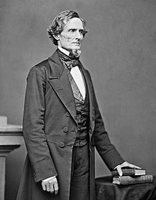
Jefferson Davis
Joins Mexican war…secures first ‘rifles”…leads “Mississippi Rifles”…war hero, appointed Senator for Mississippi
Becomes Minister for War. Supports Cuba
annexation and slavery in West…makes
Use of rifles mandatory for army. Resigns from Senate when Lincoln wins. Wants army role
Elected President of Confederacy
“hands on leader”…selects Robert E Lee
as ‘military advisor
“Forward Defence” deploys army to outside Washington
Bans export of all cotton
….Britain wants grain from North & switches
to India & Egypt
….So much for “King Cotton”
Raises bonds to have warships built secretly
In Britain for Southern Navy

Slide 10
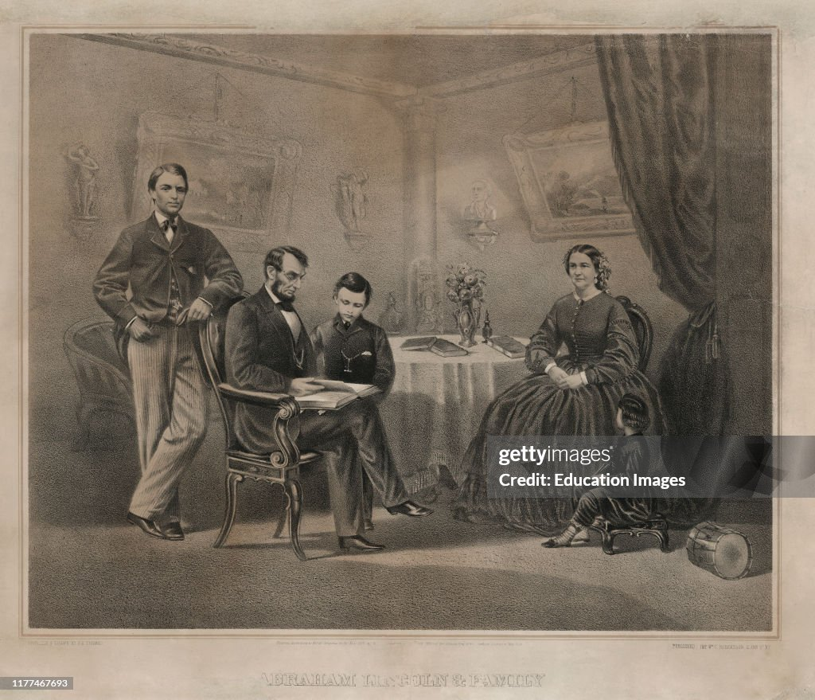
Abraham Lincoln and Family
Abraham, Mary Todd, Robert
Tad, and Eddie
Affectionate parents… children
Run rampant ….interrupt meetings
…..Lawyer quote “, "I have felt many and
many a time that I wanted to wring their
little necks, and yet out of respect for
Lincoln I kept my mouth shut.
Lincoln did not note what his children
were doing or had done.!
Youngest son Tad dies aged 8 in
White House, Mary becomes
Recluse…Abraham prone to
Depression …hidden

Slide 11
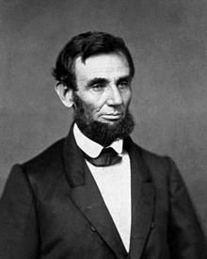
Abraham Lincoln
Defers strategy to military strategist
And field generals. Until they fail
Goal: reunite country
..not free slaves
..fires General freeing slaves
Avoid war with British and French
….Trent Affair. Returns ambassadors
…French invasion of Mexico. Ignores
Maintains control of media
Suspends “habeas corpus”, ignores Supreme Court
…jails 13,000 Southern sympathisers
Expects easy and quick victory

Slide 12
The fight to save the Union 1861-1862

Slide 13
Situation April – July 1861
Regular US Army only 16,000 strong
mostly deployed on frontier
Loyalties split
25% officers and 10% of soldiers leave to join South
Skirmishes and small battles rage across neutral border states
West Virginia chooses to secede from Virginia and join north
Davis sends Lee with army to recover.
Northern army under George McLellan outnumbers Lee 3x
Lee retreats …named “Granny Lee”….career appears over
Volunteer rush to join the armies….far more than can be armed/trained
….the first job for many………..to be photographed

Slide 14
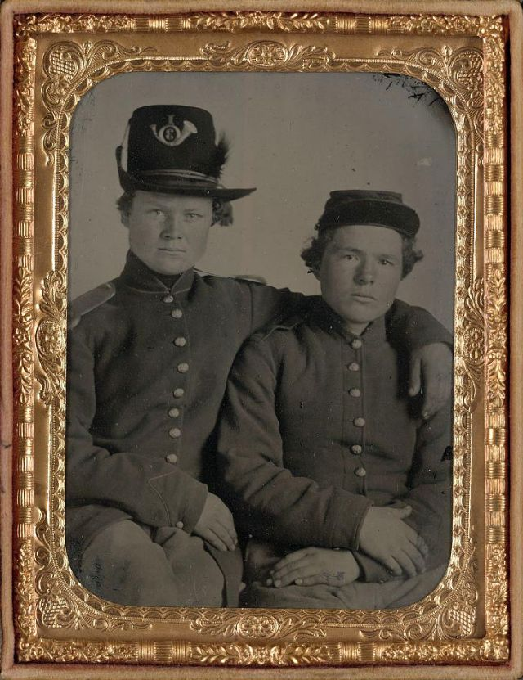
Brothers Private Hiram & William Gripman, 1st Minnesotta

Slide 15
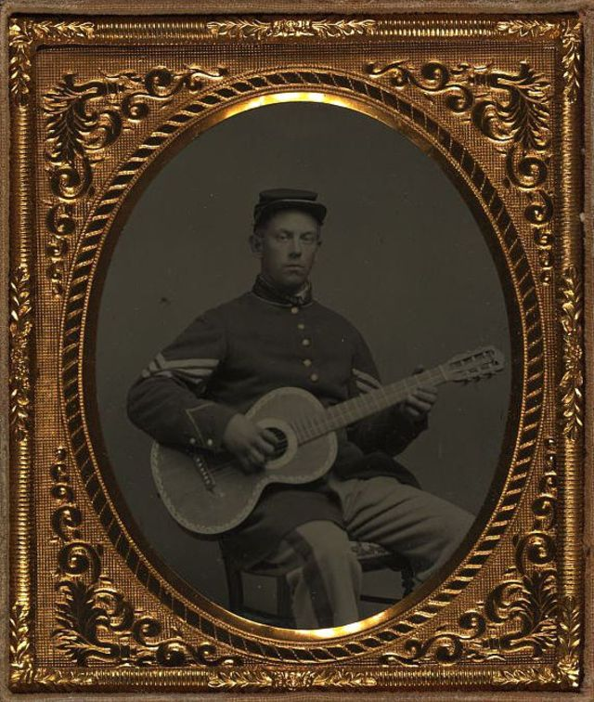
Edwin Chamberlin 11th New Hampshire

Slide 16
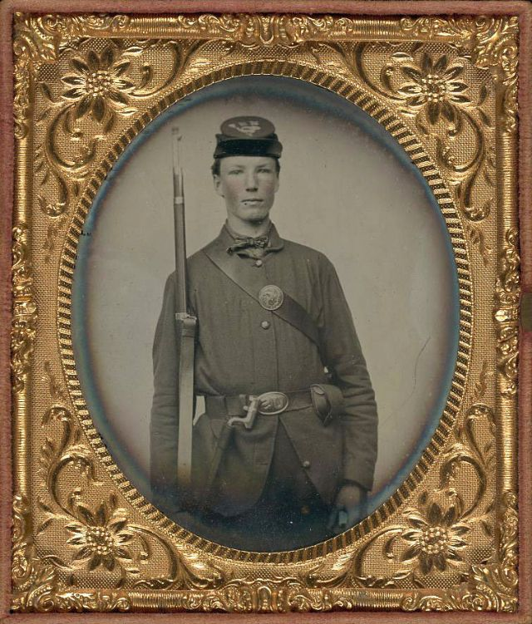
Corporal Alvin Williams 11th New Hampshire Volunteers

Slide 17
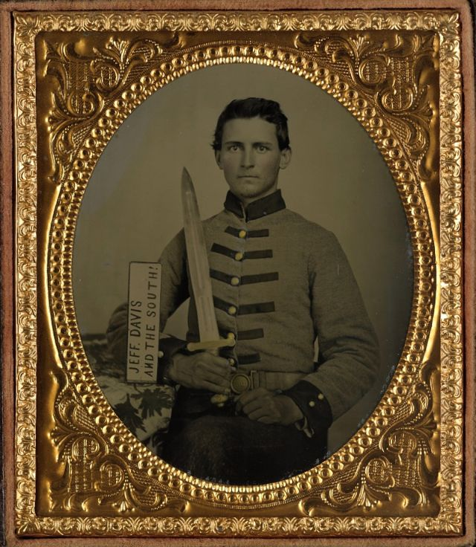
Henry Augusts Moore, 15th Mississippi

Slide 18
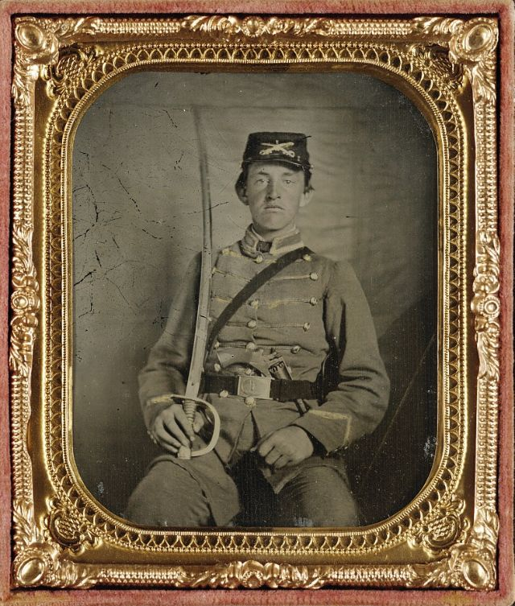
David Thatcher, 1st Virginia Cavalry

Slide 19
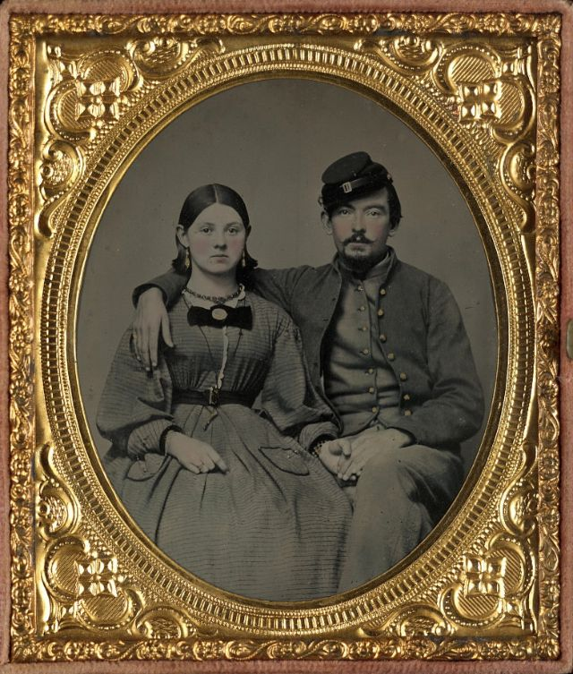
Edward Cary and sister Emma, 44th Virginia Infantry

Slide 20
Drummer Boy Samuel Doble, 12th Maine

Slide 21
Battle of Bull Run July 1861al
Situation May- June 1861
…Lincoln and Davis expect one battle and victory
…two armies each 40,000 5 miles apart “look at each other”
Situation July 1861
…. Initial 90 enlistments running out…risk army will go home
….Northern General McDowell warns "It will take a long time to make an army”
…..Lincoln’s response “Your are green, it is true. But they are green also; you will all be green alike”…orders advance

Slide 22
Situation July 1861:

Slide 23
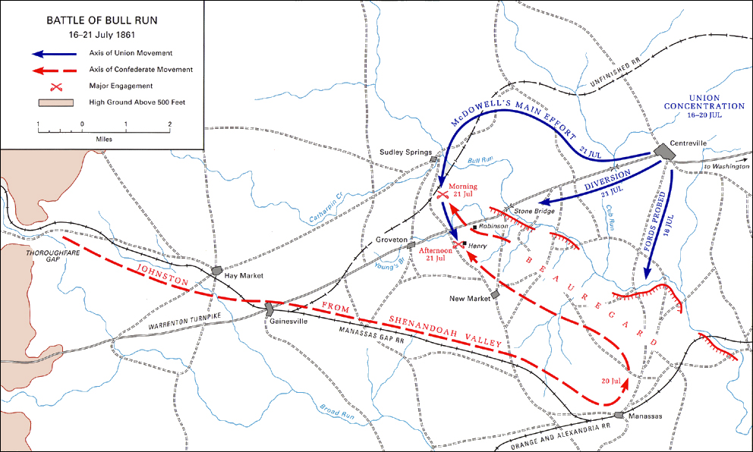
The northern plan…deceptions, diversions and surprise…elaborate & detailed,

Slide 24
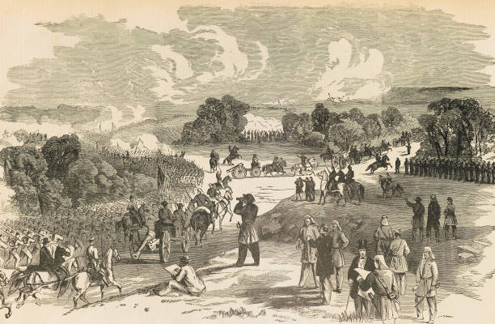
The North advance….along with sightseers
“They came in all manner of ways, some in
stylish carriages, others in city hacks, and
still others in buggies, on horseback and even
on foot. Apparently everything in the shape of
vehicles in and around Washington had been
pressed into service for the occasion.
It was Sunday and everybody seemed to have
taken a general holiday; that is all the male
population, for I saw none of the other sex
there, except a few huckster women who had
driven out in carts loaded with pies and other
edibles. All manner of people were represented
in this crowd, from the most grave and noble
senators to hotel waiters.”

Slide 25
The north attacks blocked, Southern, retreat as South reinforcement arrive by rail. Then panic

Slide 26
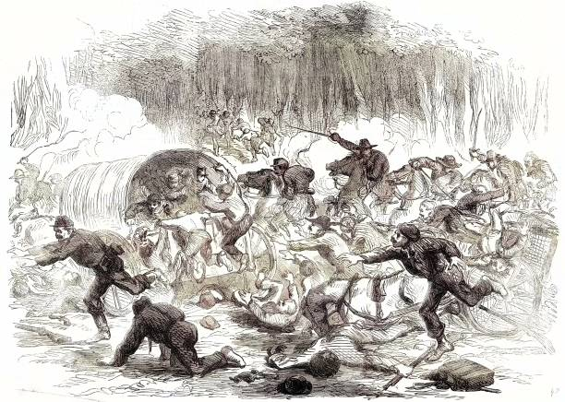
“The great skedaddle”

Slide 27
Aftermath
Bull Run largest battle fought in North America
1,500 killed and wounded each side...both sides shocked
Southern army as confused in victory as North in defeat
Both sides realise war will last years
Southern reaction:
euphoria and mourning for 500 dead
President Davis calls for 400,000 volunteers for “duration of war”
North: Shame & determination ….rally around the union
Lincoln calls for 500,000 volunteers for three year term
Forms cabinet of “best minds” in the land including Northern Democrats and
former enemies “Team of Rivals” and develops finance & military plans to win war

Slide 28
The Financial War
 | North | South
Taxes (Income and Excise) | 21% | 5%
Borrowing (internal only via Savings bonds) | 66% | 35%
Inflation ( printing money) | 13% | 60%

Slide 29
The North’s Financial Plan
Strong Central Government: Can mandate change
Lincoln has no opposition: Southern Democrats have left, rivals in Cabinet …approach British for loans…refused
Delivers “Financial Revolution”…demolishes 50 years of “states rights”
Creates US Central Bank to regulate credit
Imposes Income Tax (3% on average incomes, 10% on rich)
Creates Internal Revenue Department to oversee and collect tax
Increases tariff on imports & raises Excise Taxes
Issues $400 million in “Greenbacks” and mandates use instead of specie
Evasion/ corruption rife….but considered necessary cost

Slide 30
South Financial Plan
No central financial authority
Belief in “States Rights”
Inadequate Gold Reserves: California “free”
No foreign loans
Southern states defaulted in Panic of 1839
“Wealth” of South = cotton and slaves…British need grain> cotton and opposed to slavery
Little to no trade
Union Blockade
Smuggling occurs but not enough and no tax collected
The Only Option: Print Money and issue bonds
………effective as long as “slaves” retain value

Slide 31
North’s Strategic Plan
Developed by
Winfred Scott. Mexican
War General
Strangle the South by
Blockade and control of
Mississippi
First step rebuilt army
And take Southern capital
At Richmond
Need a strong general
…a new Napoleon

Slide 32
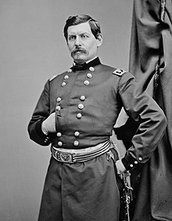
General McLellan (1826-1885)
West Point graduate, focus Strategy, artillery, fortifications
Excels in Mexican war, subordinate to Robert Lee.. Joins Democrats after war, successful Railroad Executive …observer to Crimean war.
Leads army to secure West Virginia
……battle of Rich Mountain…7,000 Vs 1,000 South …national ‘hero’
Appointed Commander “Army Of Potomac immediately after Bull Run

Slide 33
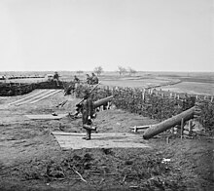
War in the East July 61- April 62
August- February McLellan builds army of Potomac t0 120,000
….manoeuvres,,, training, discipline
….no fighting
Convinced Southern army of 150,000 waiting across river (real number 50,000)
Lincoln demands action
McClellan advances February
,,no enemy..”Quaker Guns”
Develops plan to take Richmond
and avoid Southern Army
….secret…to take place in April

Slide 34
…Meanwhile in the West, things are happening

Slide 35
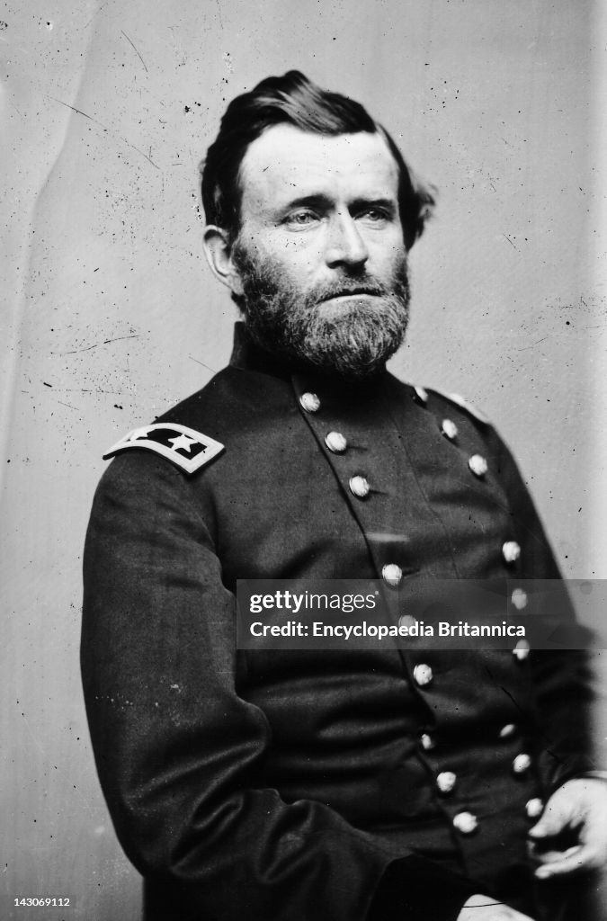
Ulysses S Grant (1822-1885)
Born Ohio, middle income
Parents, attends to West Point
21st class of 400)
Mexican War hero, marries Stationed California 1850’s, depressed, Drunk, cashiered from army
Fails in business works in tannery
Fails. Sells Xmas trees to feed
family
Joins army in July 61,, made Brigadier
Leads raid on larger Southern army at Belmont inflicts 500 casualties & withdraws
Reinforced…leads army of 20,000 to seize forts along Tennessee River

Slide 36
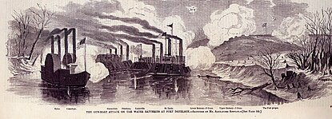
Fort Donaldson naval attack
Grant combines attack
By gunboats and army
Assault fails…does not
Give up….negative media
Attacks Southern relieving
Army,
Surrounds fort and decides to make another assault..
Before more Southern troops arrive

Slide 37
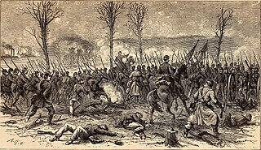
Assault on Fort Donaldson February 1862
Second assault fails,
Sends message to
Southern commander
Demanding “Unconditional
Surrender”…or face annihilation
…intimidates commander
13,000 Confederates surrender
Grant “hero of the nation”
Given command of “Army of
Tennessee”…40,000 strong
..choke South rivers

Slide 38
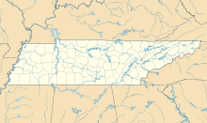
Tennessee February- April 1862
Grant moves South
With “Army of Tennessee”
Waits for “Army of Ohio”
At “Pitts Landing”
Army of Ohio
20,000
Fort Donaldson
Grant
30,000
Mississippi River
Shiloh (Pittsburgh Landing)
Confederate commander
Decides to destroy Grant
Before he is reinforced
South (Johnson) 40,000

Slide 39
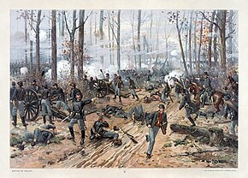
Battle of Shiloh April 6/7 1862
Ferocious Southern
Attack. Northern army
Driven back to river
Grants absent till early
Afternoon (drunk?)
Stabilises front
Army of Ohio arrives by
Boat at midnight
Told “we have had
Devil’s own day, haven’t
We?” “Yes, lick em
Tomorrow though)
`

Slide 40
Aftermath of Shiloh
Both sides lose 2,000 killed, 10,000 wounded…north lose 3,000 as prisoners
Newspapers call Grant a butcher
Lincoln told Grant a drunk “Find out what he drinks and give it to all my generals”
Grant demoted and sent to join armies moving South along Mississippi
Southern army of West
Shattered by high casualties
top General (Johnson) killed
Demoralised as news arrives that New Orleans has fallen

Slide 41
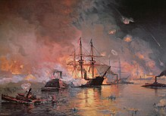
New Orleans April 1862
South relies on forts and
Gun boats… small garrison…
Army sent to Shiloh
Northern navy attacks
Demolishes forts & gunboats
Army of 15,000 occupy city
Major Southern port& city of
150,000 occupied….General
Butler enforces martial law…
Any woman insulting Northern
Officer. To be treated as “fallen
Women”
Butler offers refuge to any
Slaves…creates black regiment
South “way to sea” closed
…slaves losing value

Slide 42
Meanwhile back East McLellan has moved

Slide 43
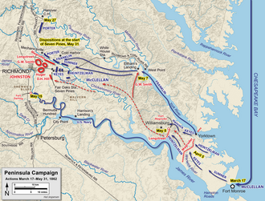
McLellan's Peninsular Campaign
March 1862 120,000 men, 44 artillery,
15,000 Horses shipped to “York
Peninsular
Local southern army of 10,000 delays
advance by deception. McClellan
Believes he is outnumbered
Moves north….South retreats to join main
Army of 60,000 around Richmond
McClellan’s army of 105,000 on outskirts of
Richmond
South appears doomed

Slide 44
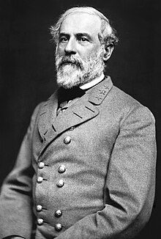
Robert E Lee (1807-1870)
Born Virginia to large plantation
Owning family, many slaves
Attends West Point, joins army
…..part time running plantation
Serves in Mexican war as scout &
strategic Advisor
Seen as premiere military leader.
Asked by Lincoln to lead North….
declines…joins South
Devises aggressive strategy on northern
Army…assumes leadership when Southern
Commander Joseph Johnson wounded at
Opening battle (Battle of Seven Pines)

Slide 45
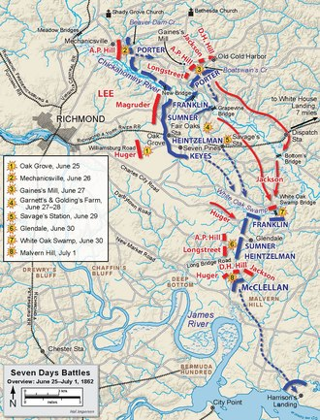
Seven Days Battles June 1862
Lee has 57,000 men and attacks army of 105,000
Lee attacks for 7 days
….repulsed every time
….20,000 Southern casualties
….15,000 North
McLellan retreats to coast …. …announces great victory vs odds?
Lincoln visits.. demotes McClellan
…creates new “Army of Virginia” ..appoints “Western General” Pope….victory river campaign
Lee decides to take war to the enemy…and convince
& British South will win….heads north

Slide 46
Lee’s first invasion of the North
Lee moves towards Washington with 60,000 men…August 1862
General Pope with advances to crush Lee with 70,000 men
Lee makes surprise attack & defeats Pope 17,000 northern losses, vs 8,000
Decides to invade Maryland….seize Baltimore & expects support
Lincoln reinstates McLellan….tells him to intercept and destroy Lee
Lee divides up army to maximise supplies
instructions found discarded by union soldiers camping
…..McClellan knows Lee’s army divided and pursues…slowly
Lee’s army of 37,000 faces Northern army of 95,000 at AntietamCreek….its annihilation looks certain

Slide 47
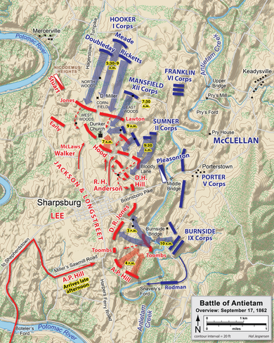
Battle of Antietam September 17, 1862
McClellan uses only 60% army
Three major uncoordinated attacks
…Lee blocks each attack
…moving troops interior lines
Last attack succeeds at first till 10,000 Southern reinforcement arrive late in day
Bloodiest day of war North 12,000 killed & wounded, South 10,000
Lee retreats South next day, McClellan
Claims great victory against great odds
Lincoln decides to use “victory” to
change scope of war

Slide 48
Emancipation Proclamation, September 1862
Issues “Emancipation Proclamation”
Declares all slaves within rebel states “free”
500,000 slaves in ‘loyal’ border states to remain slaves
Blacks encouraged to join Northern army
Motivations.
Convinced slavery cause of war and must be eliminated
Pressure from abolitionists…Garrison and Republican “base”
Needs more men….persuaded by Frederic Douglas to recruit blacks
Eliminate risk of British joining South…government can’t be seen fighting for slavery

Slide 49
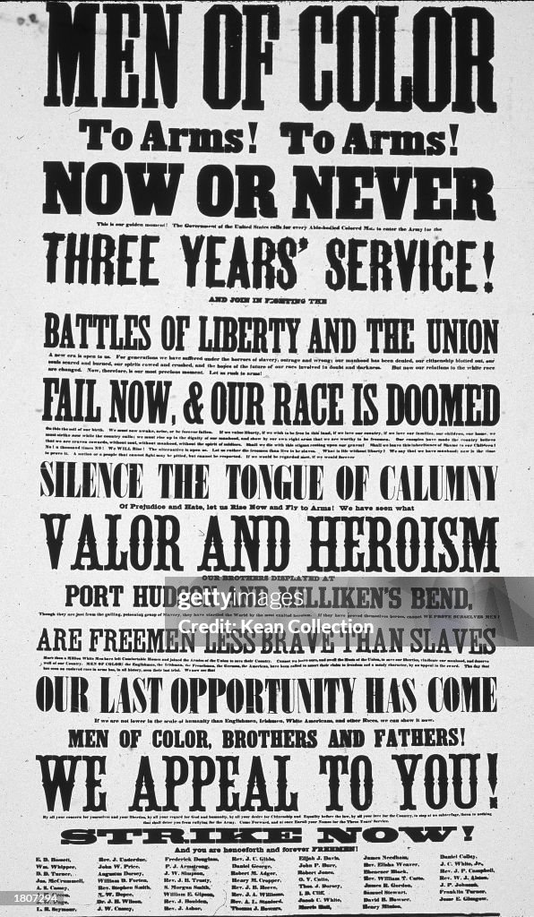
African Americans and Civil War
Recruitment Poster 1863
Douglas lobbies Lincoln & Congress
to allow Blacks to fight.. eloquent
& Immaculate..blacks can fight …but
Need a reason
Active recruitment begins after
Emancipation Proclamation…white
Officers + reduced pay
190,000 join army, 50% free, 50% ex
Slaves: (10,000 killed In fighting,
30,000 from disease)
…10% Union army by 1865
Gain equal pay after fight in 1864
…7,000 officers by end of war
South threatens to kill blacks white
Officers who they capture
…Many prisoners murdered,
…Lincoln says 1 captured to be
Shot for each office

Slide 50
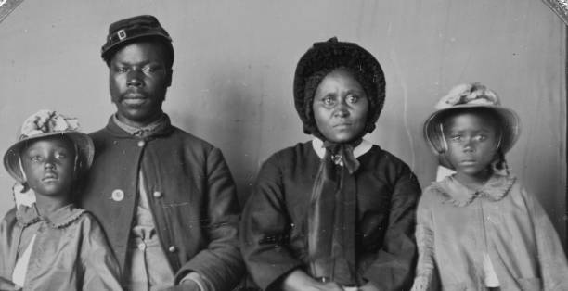
A father goes to war

Slide 51
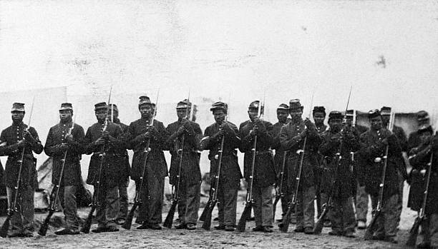
African Americans newly mustered

Slide 52
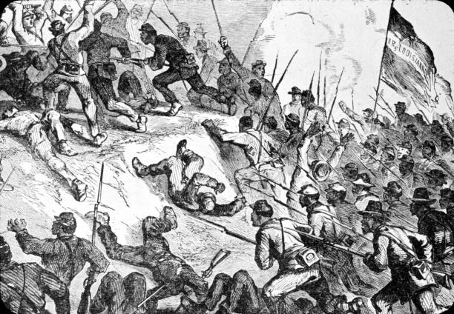
Capture of Fort Hudson July 1863

Slide 53
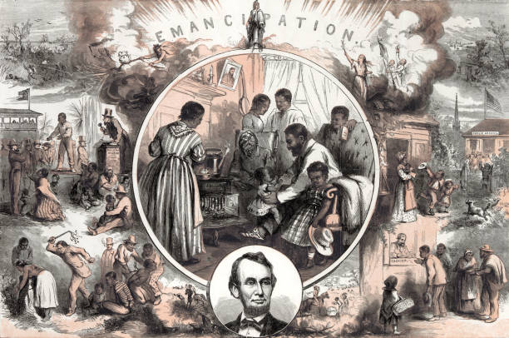
War becomes a “Mission” …Lincoln the “Emancipator”

Slide 54
War to “save union” over ...War to “end slavery” begins

Slide 55
Intermission

Slide 56
Situation end 1862
Lincoln intensifies war effort
Visits McLellan again….and fires him
Appoints aggressive (and dim) General Burnside
Authorises mass conscription
Battle of Fredericksburg December 11-15 1862
Union disaster: frontal assault, Union lose 12,000 South 2,000
South invades Tennessee, defeated at “Stones River” Dec 31st
80,000 engaged, 25,000 killed and wounded casualties

Slide 57
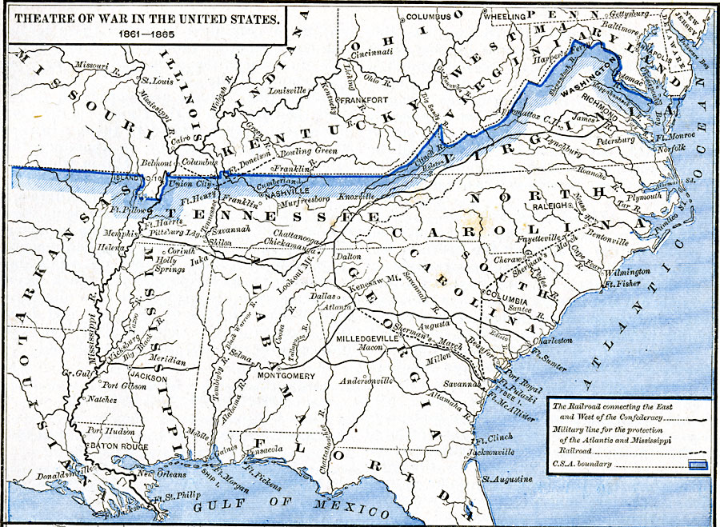
Situation January 1863
Fighting across
The country & Guerrilla war in border states
Army of
Potomac
Amy
North Virginia
Halleck, north commander
Wants South “cut in two”
by taking Vicksburg,,,needs
“killer”….Grant the man
Army of
Cumberland
Grant
Army of Tennessee
Centre Southern rail transport, supplies and men sent to Deep South from Texas & Arkansas,
Army of
Kentucky
Army of
Mississippi
Vicksburg
Grant starts campaign
February 1863
Butler

Slide 58
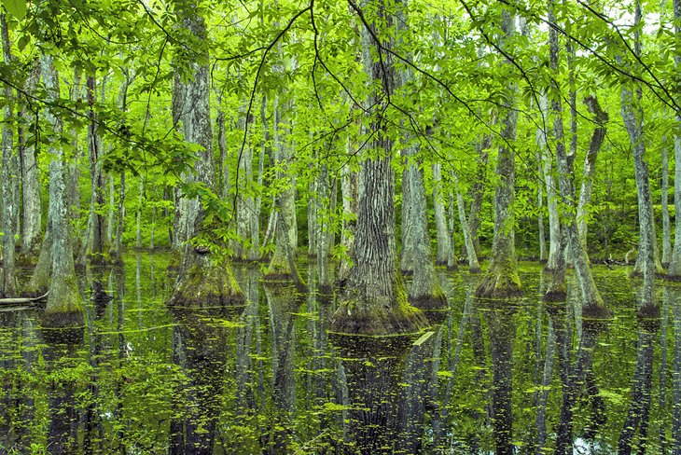
Mississippi….land of swamps

Slide 59
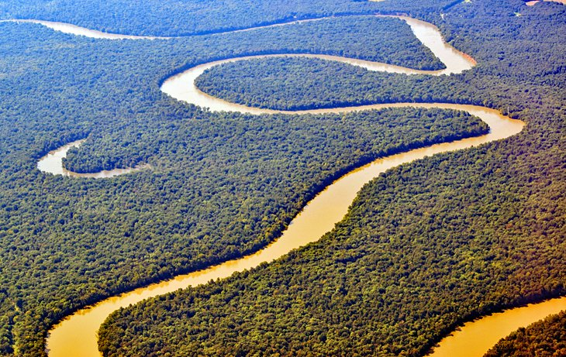
Multiple rivers

Slide 60
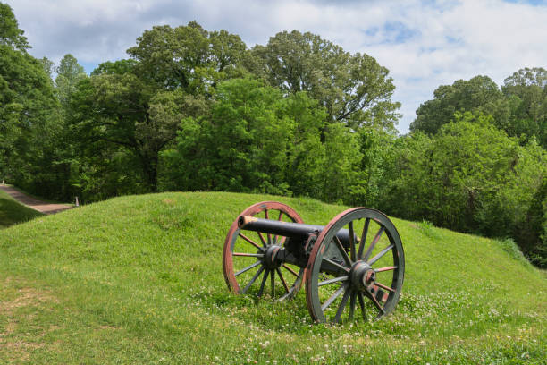
Heavily wooded…open meadows

Slide 61
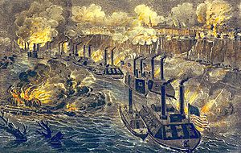
Gunboats break through…at cost
(now) ronclad gunboats
…succeed but
cannot provide
continuous supplies
Grant orders attack on city ….. Disaster loses 2,000 vs 200 South
Newspapers want
Grant fired
….claims he is a drunk
…..Lincoln “I can’t spare this man, he fights
Grant builds canals
To by pass guns….
Through swamps

Slide 62
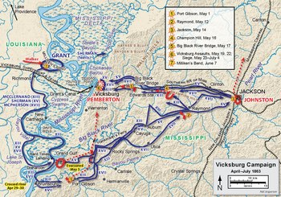
Vicksburg campaign
Grants builds army to 70,000
Crosses Mississippi
South sends army to reinforce
Vicksburg
Multiple battles, Southern
Army beaten, chased East
& .garrison to Vicksburg
Grants burns all public
Buildings in Jackson, capital
of Mississippi. Then leaves,
to turn West an besiege
Vicksburg

Slide 63
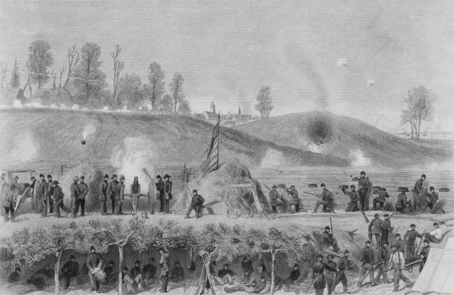
Siege of Vicksburg starts May 1862

Slide 64
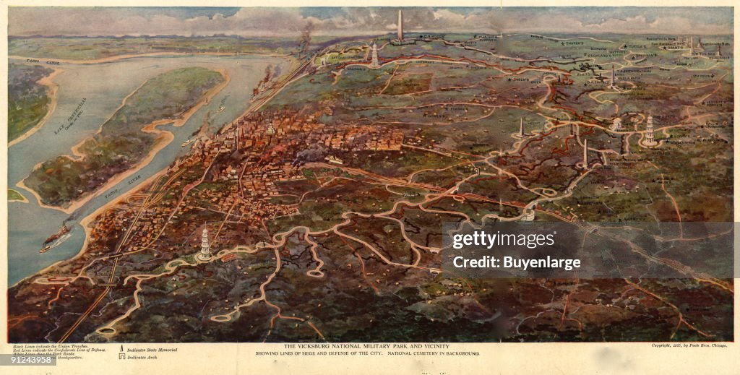
And continues into July 1863…no end in sight

Slide 65
Meanwhile back East, South on the move

Slide 66
War in the East …January – July 1863
Another new commander
“Fighting Joe Hooker” in command
Objective….find and destroy Lee’s army…direct attack towards Richmond
70 square miles mostly unmapped forest between Washington and Richmond
Joe Hooker leads army of 130,000 South April 1863 …into “wilderness”
……….., Lee divides army of 60,000…hidden by forest
…………Flanks Hooker and attacks

Slide 67
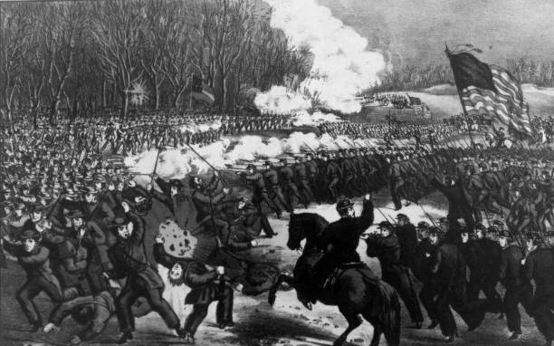
Battle of Chancellorsville April 30 – May 6, 1863
Week of intermittent
And intensive fighting
…units lost, day/ night battles …forest on fire
North surprised by furious
Flank Attack….Hooker concussed
By shell…out of action most
Of battle
North stabilises
Hooker orders retreats…
Despite objections
…convinced beaten
North loses 17,000 South 13,000 …plus best commander Stonewall Jackson
Davis orders Lee to invade North

Slide 68
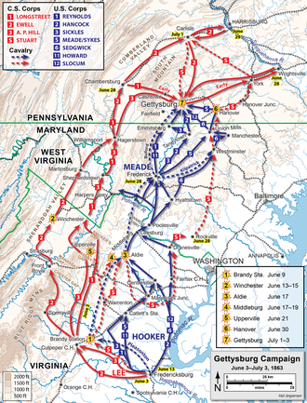
Gettysburg Campaign June ..July 1863
South moves North with army of
70,000 towards Philadelphia
…..wants supplies
…..force North to sue for peace
Lincoln fires Hooker, replaces
With competent General Meade
Meade follows Lee. Army of 90,000
…..long columns….divided up
Southern army running out of shoes
….learn shoes available at
town of Gettysburg & decide to
Seize it

Slide 69
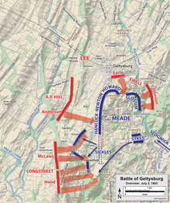
Battle of Gettysburg Days 1-2
Day 1…..Lee attacks of 70,000 drives
30,000 Northern troops
south of town to high ground south
out of town…soldiers get shoes
Day 2 Meade creates “horseshoe
Defence….goads Lee to attack as more Northern troops arrive
Lee attacks flanks on day 2
…without success
Meade holds ground…army
Builds up to 90,0000 by end of day

Slide 70
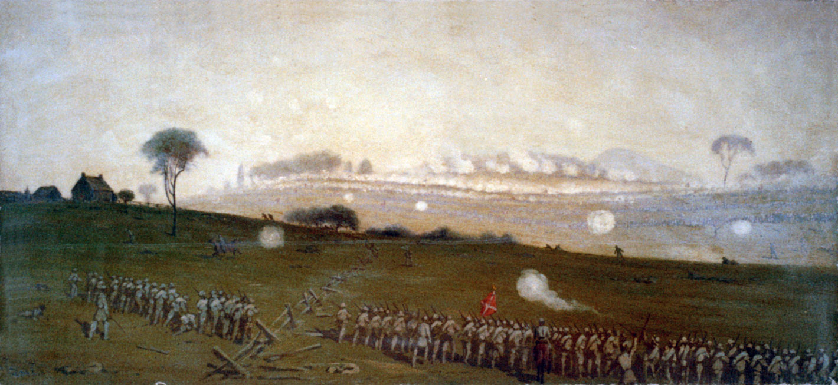
Battle of Gettysburg Day 3: …Lee decides to send his “invincible army” against Union centre: 20,000 assemble to attack

Slide 71
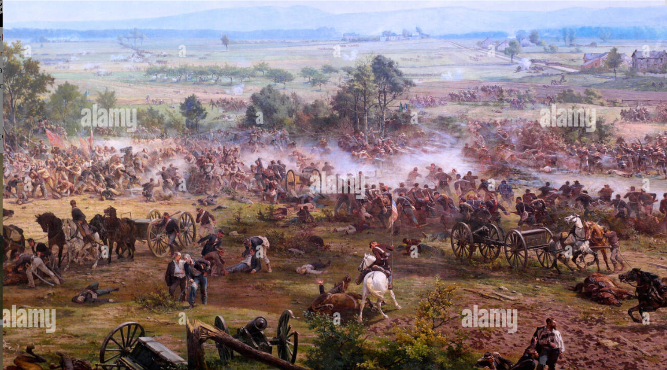
Attackers mowed down. 500 reach union line then break ...10,000 out of 20,000 killed or wounded

Slide 72
Gettysburg Aftermath
The day after..
Two armies spend July 4th looking at each other, recovering wounded & dead
South has lost 28,000, North 20,000
Meade does not pursue, stunned to have won
Lee allowed to retreat South
News arrives Vicksburg surrendered on July 4th
Entire Southern army of 30,000 captured
South is now split in two….open to invasion
Jefferson Davis realises drastic action needed to save South
Gambles Meade too timid to pursue
Needs to destroy Union army in the West and neutralise Grant and force Peace

Slide 73
Situation September 1863
Meade
Army of
Potomac
Lee Splits army of Virginia
Lee
Sends 25,000 to join
Kentucky by rail
`
Chattanooga
Army of
Cumberland
The idea: destroy
Weakest northern army
Grant
Army of Tennessee
Army of
Kentucky
Then seize Chattanooga Main rail depot for Northern supplies
Army of
Mississippi
Butler
Attack takes place
September 18th 1863

Slide 74
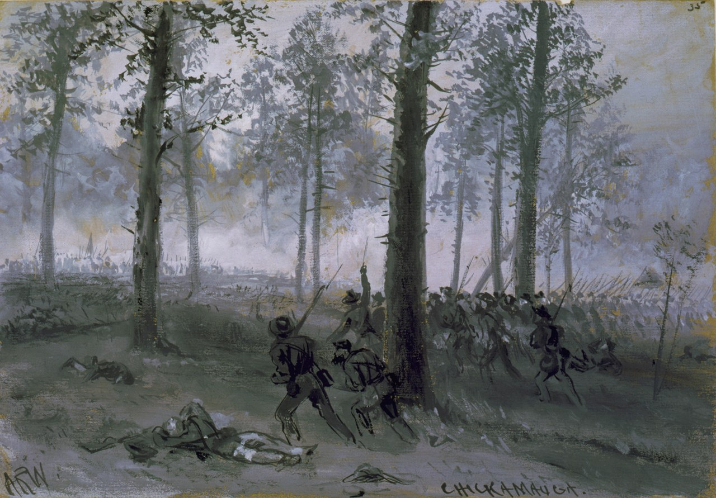
Battle of Chickamauga Sept 18-20
Only major battle
Where South has
Advantage of numbers
65,000 vs 60,000
…furious attack on Union on all
Army on both flanks
South “wins” but loses 18,000 irreplaceable men, North loses 15,000 & retreats intact to Chattanooga
Union army besieged
….feels beaten
….running low on food
….waits for Grant

Slide 75
“Siege of Chattanooga” Sept-November 1864
Chattanooga…from Confederate Lines
South “surrounds”
City…..mountains on
3 sides….expects surrender
Northern commander
Considers situation hopeless
Grant arrives, army increases
Builds supply line
increases army to 70,000 …convinced South weak
South confident….release
soldiers back to Virginia

Slide 76
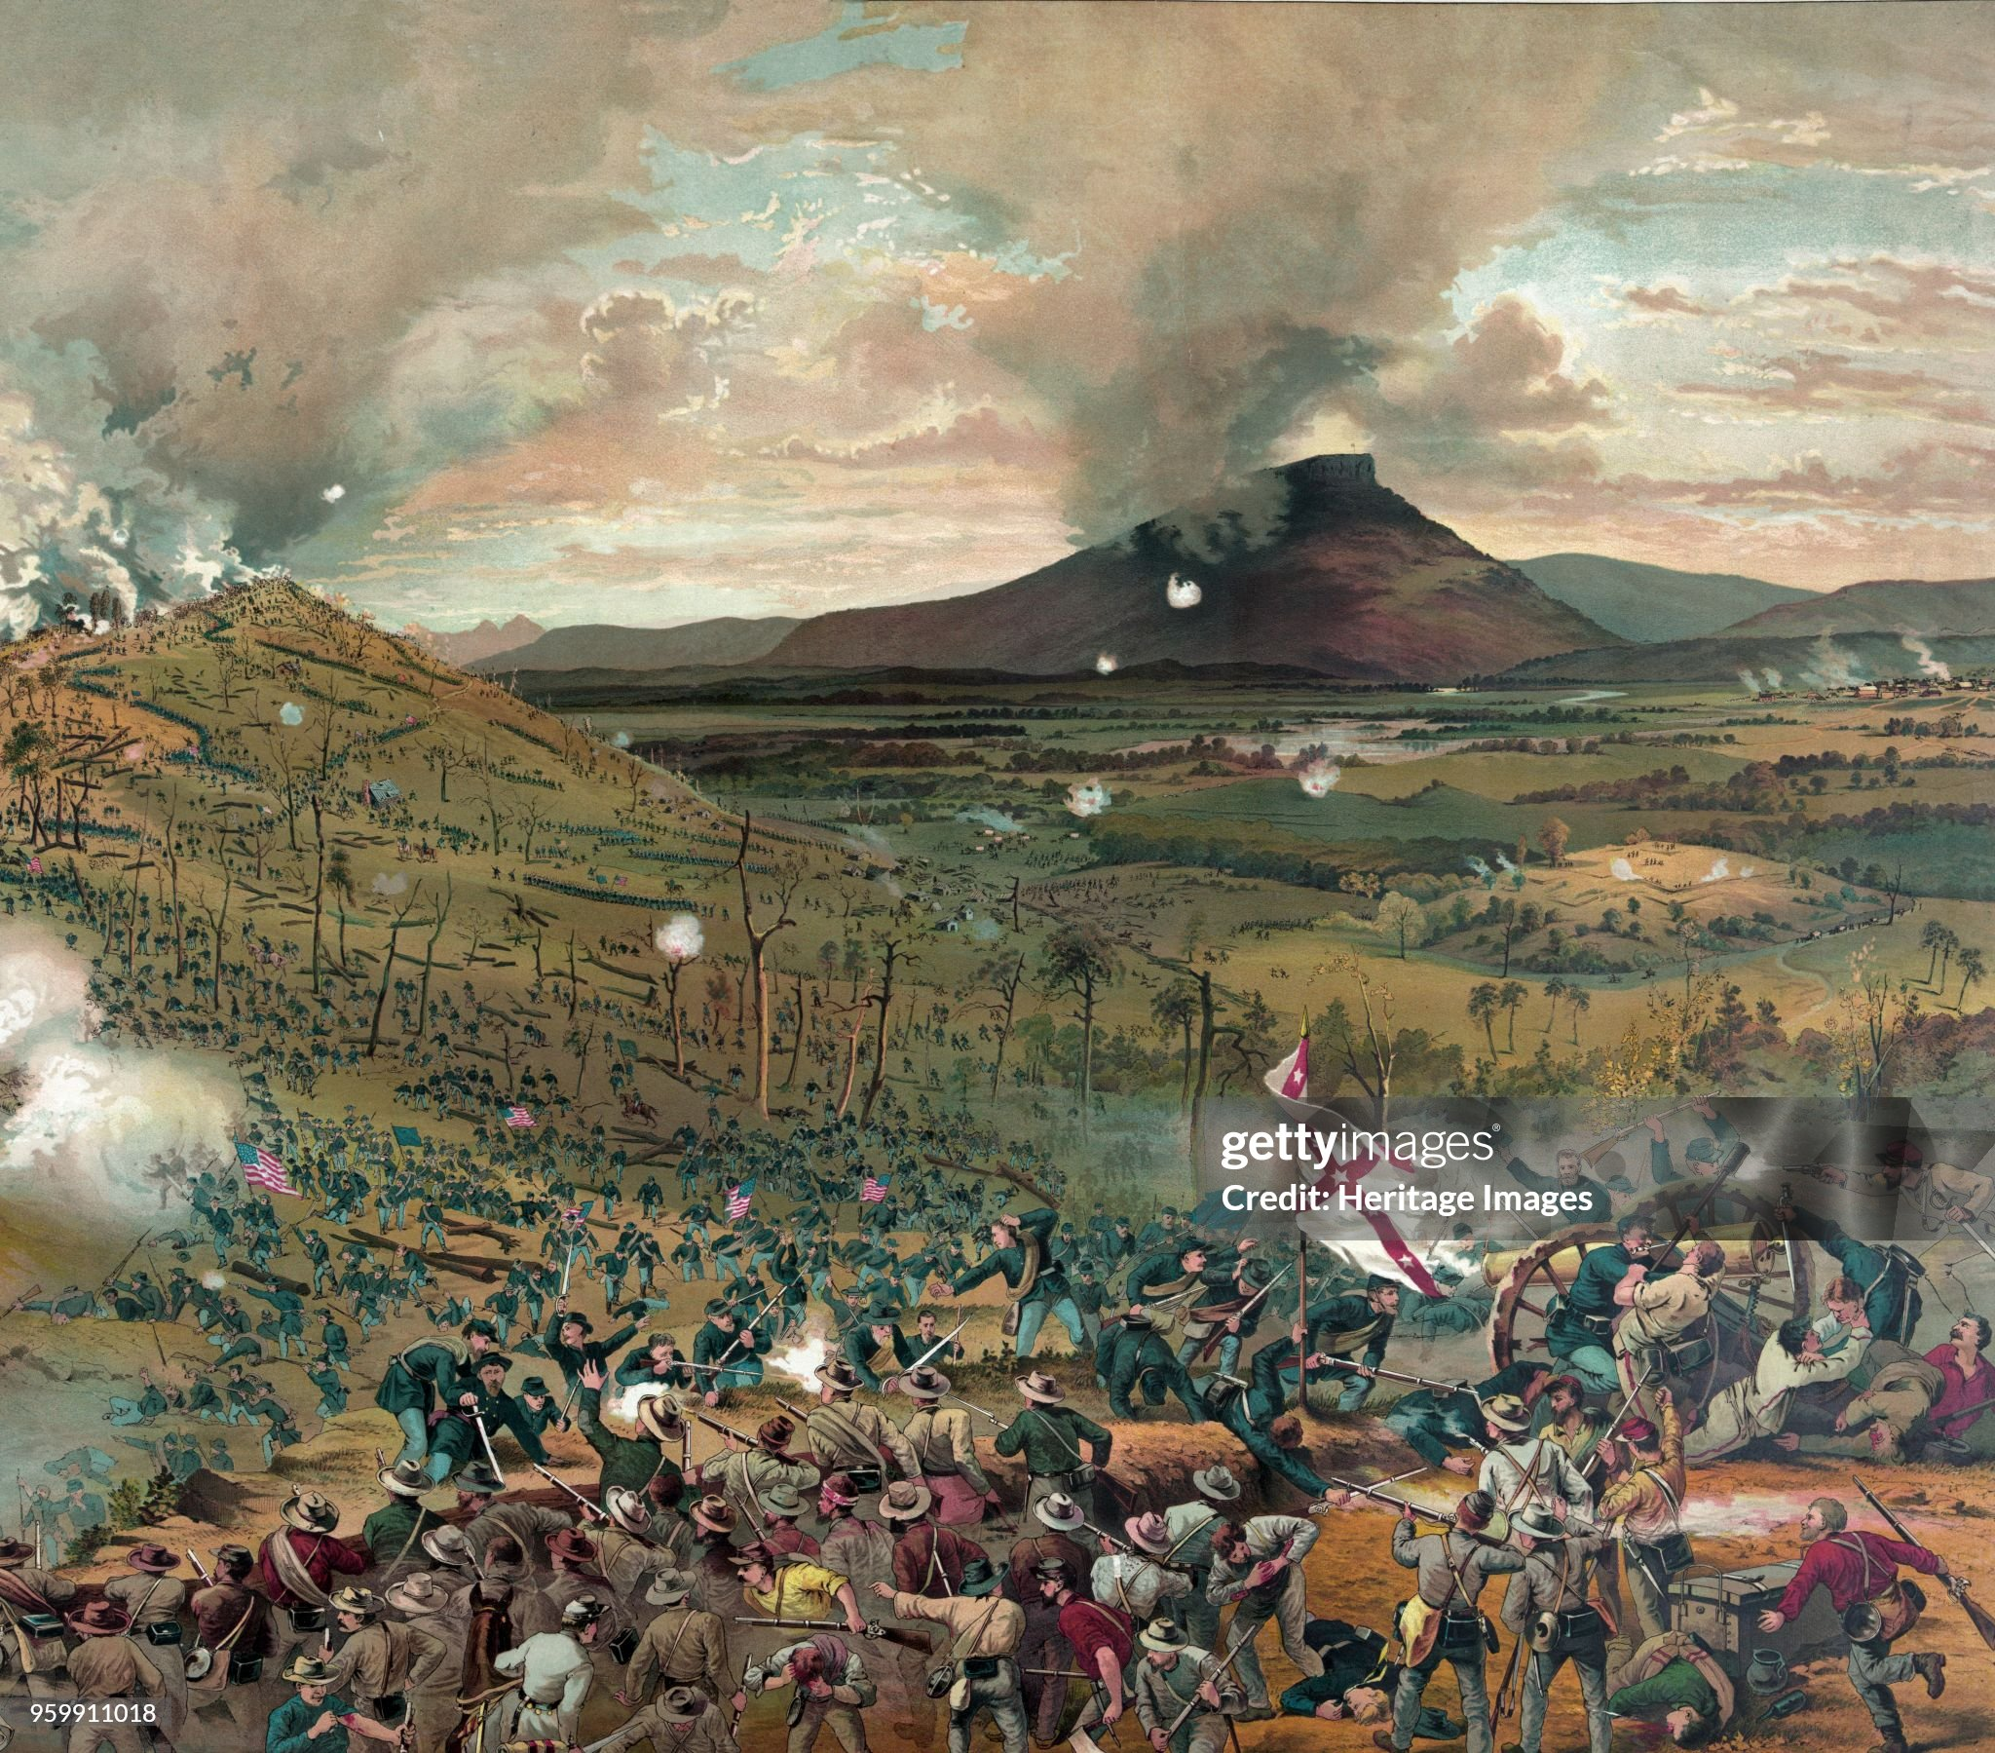
Battle of Chattanooga November 1863
Grant arrives
…resolve supply issues
…considers South weakened
…the problem “will”
Northern army attacks
….initially small scale
….whole army surges forward
North sweeps South lines….South routed..
Army disintegrates
Grants wants to pursue
…receives Telegram from
Lincoln: come East & finish
The war

Slide 77
Total war 1864- 1865

Slide 78
Northern Situation 1864
Election will take place in November
“Northern Democrats” break from coalition ..known as “Copperheads”
Offer South “Peace” ..re-join union with guarantees to retain slavery
Leading candidate McLellan, popular with troops
Internal unrest
Mass conscription introduced March 1863...$300 bounty system
….”poor man’s war”
Resentment vs rampant corruption
Racism…..war to eliminate slavery creates backlash
…and fear mass black migration north taking jobs

Slide 79
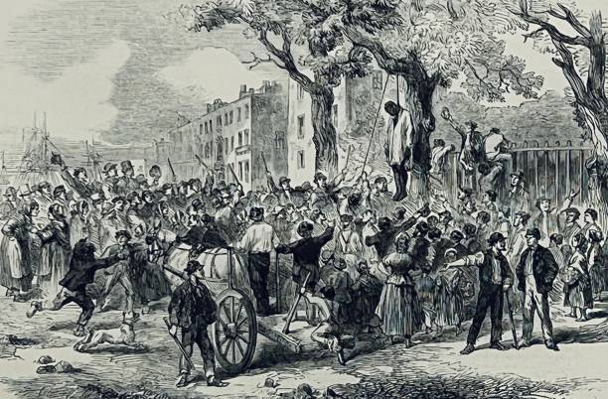
Draft Riots New York 1863
Irish immigrants tricked
..applying for citizenship
…attempt to conscript
..becomes race riot
..11 blacks hanged
NY Times “the body of the one hung in the morning presented a shocking appearance at the Station-House. His fingers and toes had been sliced off, and there was scarcely an inch of his flesh which was not gashed.
120- 1,000 killed…army
Restores order,,,
City rallies to support blacks
Black troops parade

Slide 80
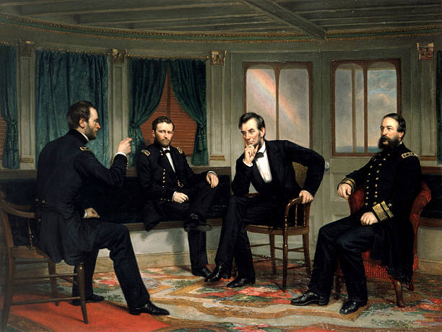
The War Summit: January 1864
Lincoln appoints Grant Supreme Commander summons him. Sherman & Admiral Porter to White House
Tells Grant “Lee's army will be your objective point. Wherever Lee goes, there you will go also.”
South must be destroyed militarily and economically
… attacked everywhere and simultaneously
Propose Constitutional
Amendment 13 ban slaver
Everywhere
…without compensation

Slide 81
Situation May 1864
Grant orders simultaneous attacks to May 1864…leads Army of
Potomac…Meade capable subordinate
Grant
120,000
Lee
60,000
Richmond
Sherman to take Atlanta
Grant Lee & Richmond
Diversionary attacks to
Texas, Florida& Alabama
…use “states rights”vs South
…soldiers will desert to defend
homes
Sherman
110,000
Johnson 60,000
Atlanta
Southern cities to be burned,
Infrastructure wrecked
Slaves to be liberated
given choice to stay
Or join army

Slide 82
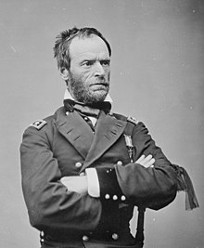
William Tecumseh Sherman (1820-1891)
Born to wealthy Ohio family. West point graduate, considered Brilliant strategist. Happily married 7 children
Stationed California during Mexican war
…watches army disintegrate
when Gold discovered, suffers depression
Commands brigade at 1st Bull Run
Sent West…nervous breakdown,
Retired…brought back by Grant
& Halleck
Subordinate to Grant at Shiloh,
Vicksburg, Chattanooga…trusted
Intelligent, ruthless
"If you can whip Lee and I can march
to the Atlantic I think ol' Uncle Abe
[Lincoln] will give us twenty days
leave to see the young folks."^{[126]}

Slide 83
Atlanta Campaign May- July 1864
Sherman advances with
110,000 men
Avoids assaults….flanks
Southern armies to force
them to attack
Southern army retreats
…changes command
…new general Hood
…attacks but repulsed
,,,30,000 losses each…
Sherman can replace
Siege of Atlanta starts
July 1864

Slide 84
Grant at Wilderness Battlefield May 6, 1864
Taken at time of Battle of
Wilderness….Lee has ljust
Launched surprise flank attack.
Subordinates and press expect
Grant to announce retreat….like
Hooker
Grant response“Quit thinking about what Bobby
Lee's gonna do to us and start
thinking about what we're going
to do to him”.
Launches counter attack

Slide 85
Grant’s Overland Campaign:May 6 –June 12 1864
Grant leads army of
125,000 South to
Destroy Lee…attempts
To get through Wilderness
Before Lee arrives with
70,000 men. Including
Survivors from West
Fails …Lee always gets there
first and entrenches/ log
barriers
….6 weeks fighting through
Forests
Battles of Wilderness,
Spotsylvania Court House
Santa Ana, and Cold Harbour

Slide 86
Battle of the Wilderness May 5-7 1864 18,000 Union 11,000 Southern causalities

Slide 87
Battle of Spotsylvania May 9 -21 1864 19,000 Union, 13,000 Southern casualties

Slide 88
Battle of Cold Harbour May 31June 9th, 1864 Frontal assault: 13,000 Union, 4,000 Southern

Slide 89
Siege of Petersburg: June 1864 – April 1865
Grant abandons direct
Assault on Richmond
58,000 causalities, vs
35,000 for South
Moves army south
Surrounds city of
Petersburg…..unable
To break lines
Extended siege with
Trenches
….war of attrition
….defence dominant
….North can replace
losses, South cannot

Slide 90
Direct attacks fail

Slide 91
Transition to trench warfare

Slide 92
Siege of Petersburg continues……

Slide 93
Situation August – November 1864
Sherman Abandons & burns
Atlanta…splits army
Leads 60,000 “March through
60,000 to defend Tennessee
Lee
Southern army invades
Tennessee. Expects Sherman
To garrison Atlanta
…army destroyed at battles
Of Nashville & Franklin
…use of black troops
Grant
Thomas
Sherman
Hood
Lee’s army besieged
Despatches Raid vs
Washington…disrupt
Election…shocks public
…army destroyed
At battle of Winchester

Slide 94
Atlanta post Sherman ….population removed, public building burned

Slide 95
Industrialised destruction of Georgia

Slide 96
March through Georgia
The idea: destroy the South: “Make Georgia Howl”
Atlanta burned to the ground rather than garrisoned
All plantations, railroads, warehouses, factories in 50 mile wide of march burned
100,000 slaves freed
Sherman quotes…..
“War is cruelty, no use trying to reform it, the sooner it is over the better
“We can make war so terrible and make them so sick of war that generations pass away
before they again appeal to it.”
“If I had my choice I would kill every reporter in the world, but I am sure we would be
getting reports from Hell before breakfast.”

Slide 97
Election 1864
Mass opposition to Lincoln and war
More deaths during 1864 than prior 2 ½ year Grant’s campaign…85,000 deaths since May
No progress Petersburg: Media claim Grant an incompetent drunk and butcher
Sherman’s army “somewhere in Georgia
Attempt to seize Washington
Candidates
Republicans re-nominate Lincoln, choose Democrat from Tennessee, Andrew Johnson
Democrats, General McLellan “Little Mac”….and war hero?
The issue
McLellan offers compromise peace, retention of slavery within union
Lincoln “unconditional surrender of South
First election with “postal vote”….2 million men under arms

Slide 98
Democrat Poster
Republican Poster

Slide 99
Northern Democrat pro McLellan rally

Slide 100
Lincoln accused of promoting “miscegenation”

Slide 101
Pro Lincoln Poster

Slide 102
Republican poster…arrogant Sout

Slide 103
1864 Election result….closer than expected
Southern states
no vote
Lincoln wins with 55% of Vote (75% of army)
…..112 electoral votes
…...21 for McLellan

Slide 104
The South January 1865: Situation Desperate
Currency worthless
Wealth evaporating
… price of slaves falls from m $1,000 1861 to $50 ( S Carolina)
Army’s losing more from desertion
Fighting, unable to conscript
.. soldiers return to protect homes
Davis sends negotiators to meet Lincoln
Seeking terms
….none offered
…surrender must be unconditional
,,,rejects terms

Slide 105
Situation Jan- April 1865
Sherman advancing
North/ Lees army
Disintegrating due to
desertion
Lee
Lee decides last gamble
… abandon defences
…rush South to crush Sherman
Grant
Richmond abandoned
Burn bridges
…fire spreads
…advancing Union army extinguishes
Lincolns decides to visit
Thomas
Johnson
Sherman
Grant anticipates move
,,,,encircles Lee
…multiple battles
… South trapped
Lee asks for terms

Slide 106
The surrender April 9th 1865

Slide 107
The war ends
Grant allows Lee’s army of 28,000 men to go home
Remaining Southern armies surrender during following weeks
Lincoln announces war’s end
Non triumphant…. Enemies now our friends
Advocates extension of the vote to blacks
Meets with Cabinet to develop plans for readmitting Southern States
Invites cabinet to join him and Mary to see new comedy “Our American Cousin” at the Ford Theatre

Slide 108
….then this happens

Slide 109
Next Talk. Aftermath and Reconstruction 1865-1877

